Slide 1

PBI BIG DATA ANALYTICS - KIMIA FARMA X RAKAMIN ACADEMY
KIMIA FARMA
SALES REPORT
Presented by Ridho Aditya Rachman
GITHUB
LINKEDIN

Slide 2



Ridho Aditya Rachman S.T
Lulusan baru Teknik Elektro dari Universitas Telkom dengan konsentrasi dalam Machine Learning dan Deep Learning. Memiliki minat yang tinggi dalam bidang data science serta keahlian dalam machine learning, analisis data, dan visualisasi. Berpengalaman dalam mengerjakan proyek-proyek berdampak besar, seperti menurunkan tingkat attrisi karyawan secara signifikan dan mengembangkan solusi otomatisasi. Terampil dalam Python, SQL, dan alat visualisasi data. Siap berkontribusi dalam tim dinamis untuk menyelesaikan tantangan di bidang data.
Bandung
eric.ridho88@gmail.com
Ridho Aditya Rachman

Slide 3

ABOUT COMPANY
Kimia Farma is the first pharmaceutical industry company in Indonesia, established by the Dutch East Indies government in 1817. The company was originally named NV Chemicalien Handle Rathkamp & Co. Following the nationalization policy of former Dutch companies in the early days of independence, in 1958, the Government of the Republic of Indonesia merged several pharmaceutical companies into PNF (Perusahaan Negara Farmasi) Bhinneka Kimia Farma.
On August 16, 1971, the legal status of PNF was changed to a Limited Liability Company (Perseroan Terbatas), and the company's name was changed to PT Kimia Farma (Persero).
On July 4, 2001, PT Kimia Farma (Persero) changed its status once again to a public company, becoming PT Kimia Farma (Persero) Tbk, referred to as "the Company" in subsequent mentions. Along with this change, the Company was listed on the Jakarta Stock Exchange and the Surabaya Stock Exchange (which have since merged and are now known as the Indonesia Stock Exchange).
With decades of experience, the Company has grown into an integrated healthcare service provider in Indonesia. It has become a prominent player in the nation's development, particularly in improving the health and well-being of the Indonesian people.
OVERVIEW
FAUGET

Slide 4

BACKGROUND
BACKGROUND & OBJECTIVE
Virtual internship with Rakamin Academy as a Data Analyst Intern.
OBJECTIVE
To analyze and create a sales report using Kimia Farma's data.

Slide 5
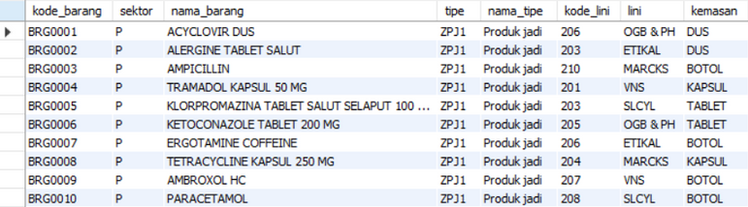
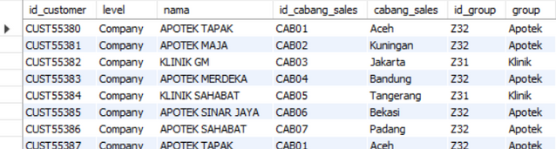
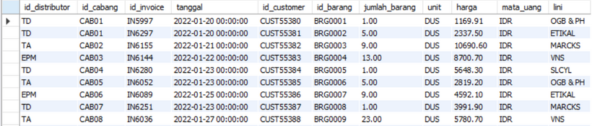
SALES
2022
BARANG
DATASET OVERVIEW
PELANGGAN
PENJUALAN

Slide 6
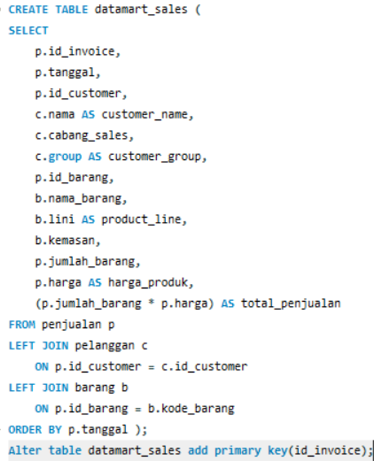
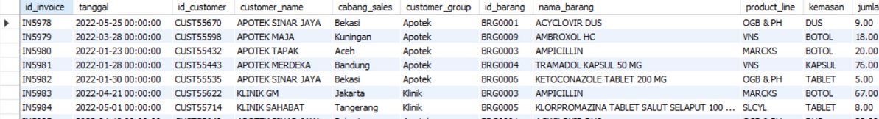
DATAMART DESIGN
QUERY
TABLE
Purpose
Combination of Sales, Customers, and Products tables.
Optimized for efficient data analysis and reporting.

Slide 7
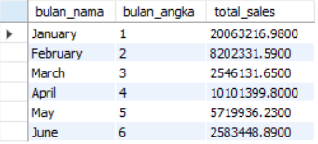
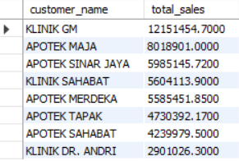
AGGREGATED TABLE
TOP CUSTOMER TABLE
MONTHLY SALES TABLE

Slide 8
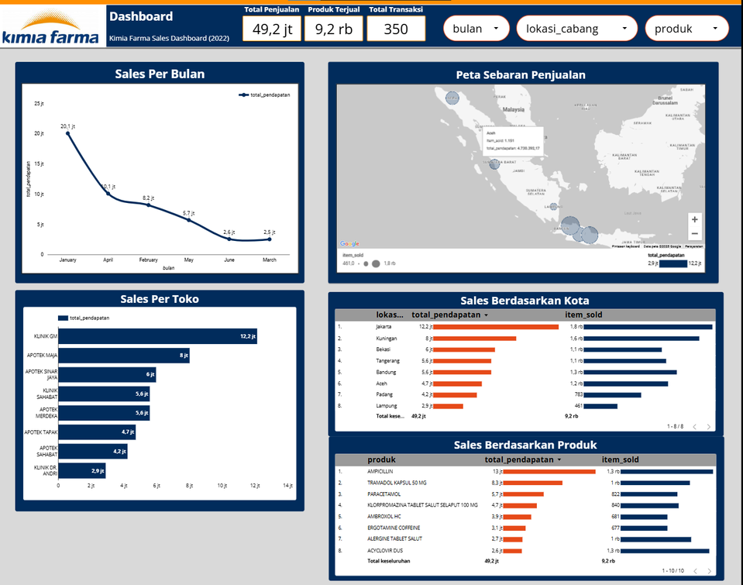
DATA VISUALIZATION (LOOKER STUDIO DASHBOARD)
Key Metrics:
Total Sales: Rp. 49.2 M
Total Products Sold: 9.2 K
Total Transactions: 350
Sales Report Dashboard (2022)
Interactive dashboard to analyze sales trends and performance.
Link to Dashboard: https://lookerstudio.google.com/reporting/1cf91be9-8afb-46d7-99ff-595fb2618fce

Slide 9

KEY INSIGHT
TOP 3 SALES BY CITIES
TOP 3 SALES BY PRODUCT
JAKARTA (KLINIK GM) - RP. 12.2 M
AMPICILLIN - RP. 12 M
2. KUNINGAN (APOTEK MAJA) - RP. 8 M
2. TRAMADOL KAPSUL 50 MG - RP. 8.3 M
3. BEKASI (APOTEK SINAR JAYA) - RP. 6 M
3. PARACETAMOL - RP. 5.7 M

Slide 10
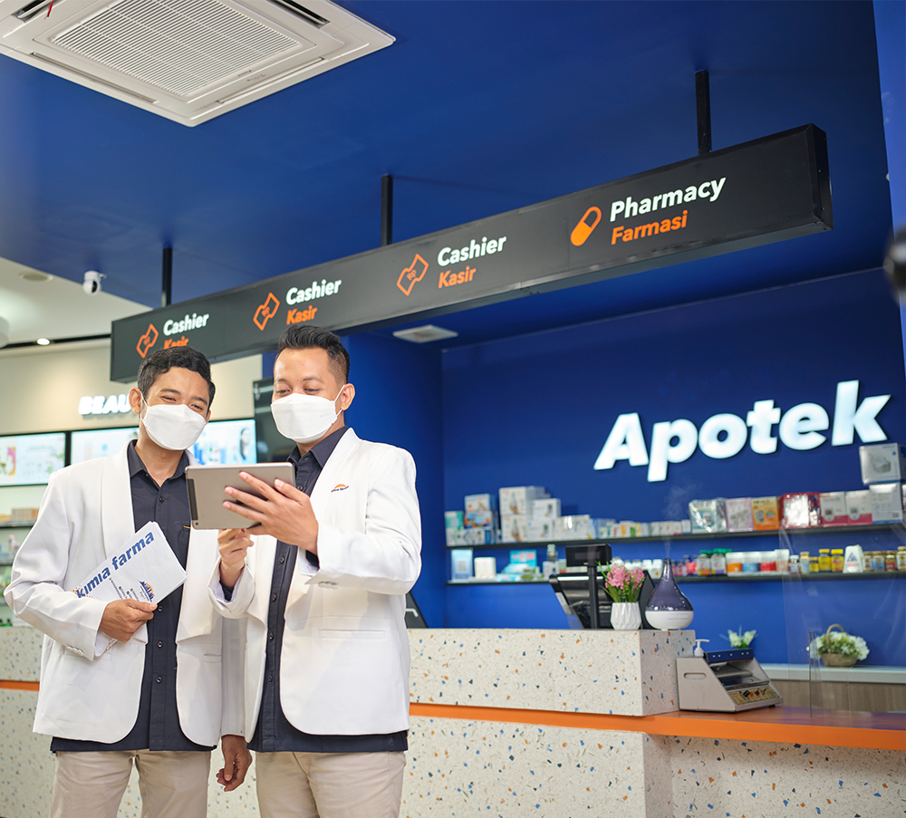
MONTHLY SALES ANALYSIS
Observation
Sales declined month by month.
Significant drop in Ampicillin sales from January (750 units) to February (102 units).
Analysis
Potential inventory issues or seasonal demand fluctuations.
Inefficient stock replenishment or supply chain disruptions.

Slide 11

BUSINESS RECOMMENDATIONS
Warehouse Management
Ensure top 3 products are consistently stocked.
Maintain minimum stock for non-popular products.
Business Development
Expand stores in cities near Jakarta (e.g., Depok, Bogor).
Launch seasonal promotions to maintain sales momentum.
Inventory & Supply Chain
Implement real-time inventory tracking.
Collaborate with suppliers for a steady supply chain.

Slide 12
CONCLUSION & IMPACT
Summary
Impact
Identified key sales trends and insights.
Provided strategic business recommendations.
Enhanced decision-making for inventory management.
Informed business development strategies.

Slide 13





THANK YOU FOR YOUR ATTENTION
CONTACT
eric.ridho88@gmail.com
https://github.com/ridhoditya
Ridho Aditya Rachman
CONTACT
Let's connect and discuss more about data analytics and business insights!

